Slide 1
Inspire Create Transform

Slide 2
What ?
Introduction
What ? Why ? How ?
Apply mathematical concepts in software development.
Why ?
With mathematical abstractions is possible write better software.
How ?
TBD // f: m -> cs[m]

Slide 3
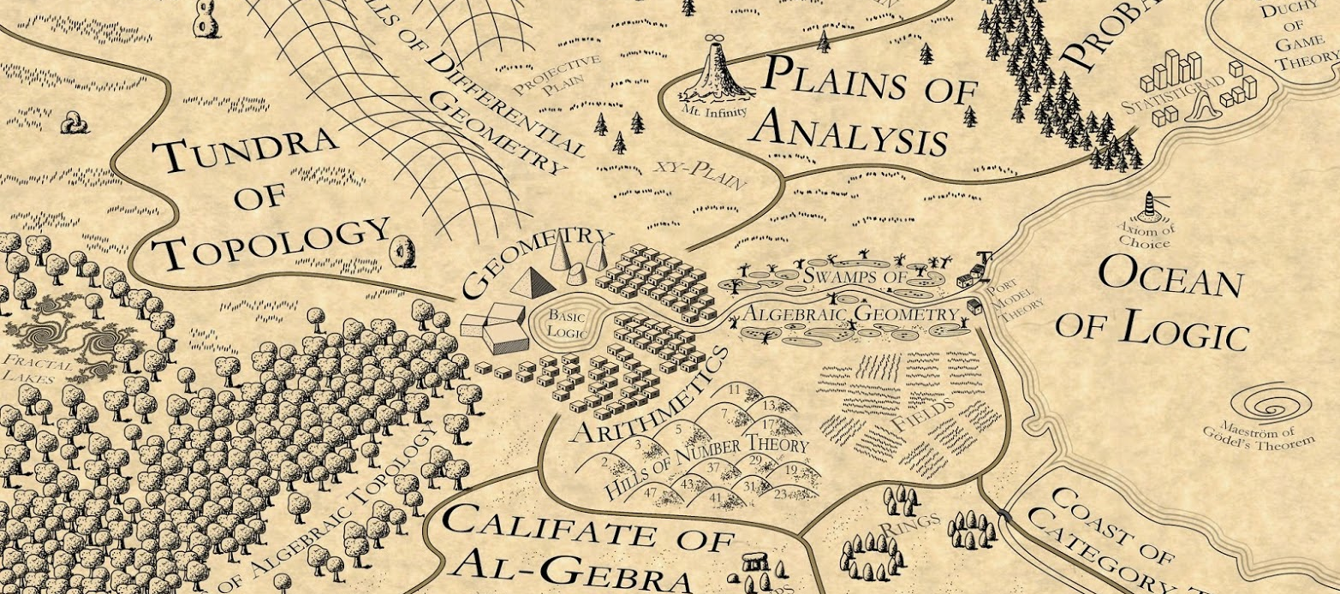
Introduction
Where?

Slide 4
Mathematics
philosophy of mathematics
Structural Foundations
Categories and Sheaves 🔴
Sheaves in Geometry and Logic
Higher Topos Theory
Topology and Geometry
geometry, topology
general topology
algebraic topology
homotopy theory 🔴
rational homotopy theory
differential geometry
differential topology
algebraic geometry
noncommutative algebraic geometry
noncommutative geometry
higher geometry
Lie theory
Algebra:
universal algebra
higher algebra
group theory
representation theory
algebraic approaches to differential calculus
homological algebra
gebras
Analysis
nonstandard analysis, functional analysis, operator algebras
Discrete mathematics:
set theory, category theory, higher category theory 🔴
graph, directed graph, quiver, order, poset, filter,
proof assistants:
based on plain type theory/set theory:
Metamath, Mizar, NuPRL, Isabelle, HOL
based on dependent type theory/homotopy type theory: 🔴
Coq, Agda, Lean, Arend
For monoidal category theory:
DisCoPy
For higher category theory:
opetopic type theory
Globular, homotopy.io
projects for formalization of mathematics with proof assistants:
Archive of Formal Proofs (using Isabelle)
ForMath project (using Coq)
MathScheme
UniMath project (using Coq)
Xena project (using Lean)
Introduction
Where?

Slide 5
Scope
Literature Review
Curry Howard isomorphism
Programming
and
Homotopy
Type Theory​
Programming
and
Applied
Category Theory
In logic, every proposition can be viewed as a type whose members are the proofs of that proposition.
🕳️ 🐇
Dependent Types
Functional
Programming
​
Types that depend on elements of other types

Slide 6
Literature Review
Keywords
Curry–Howard correspondence
Curry–Howard isomorphism
Dependent types
Dependent types in Haskell
Dependent types in Rust
Dependent types in JS // TS
Programming dependent Types

Slide 7
Literature Review
Texts
Local
Teoría de categorías aplicada a la programación funcional con Agda - Universidad EAFIT, Medellín, Co.
Coinducción: de la Teorı́a de Categorı́as a la Programación Funcional. – UNAM, Mexico.
Bounded generics over constants in Rust - Universidad de los Andes, Colombia
* A Specification for Dependent Types in Haskell.
* Dependently Typed Programming in Agda.
* Dependent Types at Work.
* Dependent Types for JavaScript.
* Dependent types in haskell: theory and practice.
* Type Inference, Haskell and Dependent Types.
* Type Theory & Functional Programming.
* One Monad to Prove Them All

